Slide 1


Submitted By:-
0mer jabbar( 4768-FOC-BSSE-F23A)
mesum Abbas( 4736-FOC-BSSE-F23A)
syed bilal ali( 4748-FOC-BSSE-F23A)
Ahmed bilal( 4598-FOC-BSSE-F23A)
Submitted T0:-
Dr.prof Shakeel Ahmed
Data structure&algorithm

Slide 2
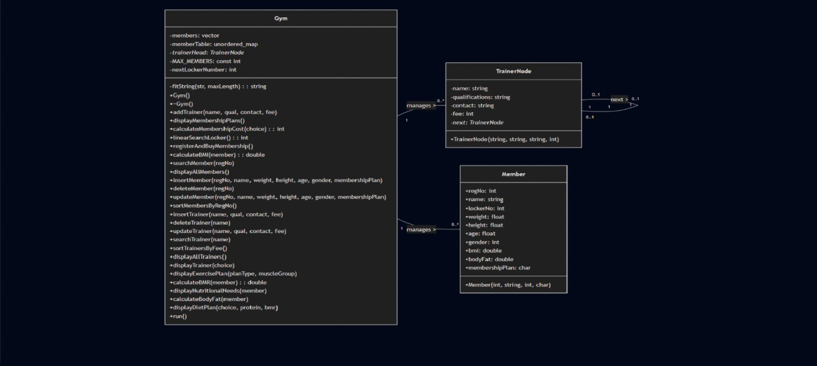
Class diagram for GYM managment system:-

Slide 3
Class digaram explianation
The class diagram correctly represents the Member entity with attributes like name, age, contact, and locker number. System-level functions such as adding, displaying, and searching members are shown clearly. The use of vector and map

